Slide 1
DETROIT Comeback City
Presentation to Leadership Detroit
November 17th, 2016

Slide 2
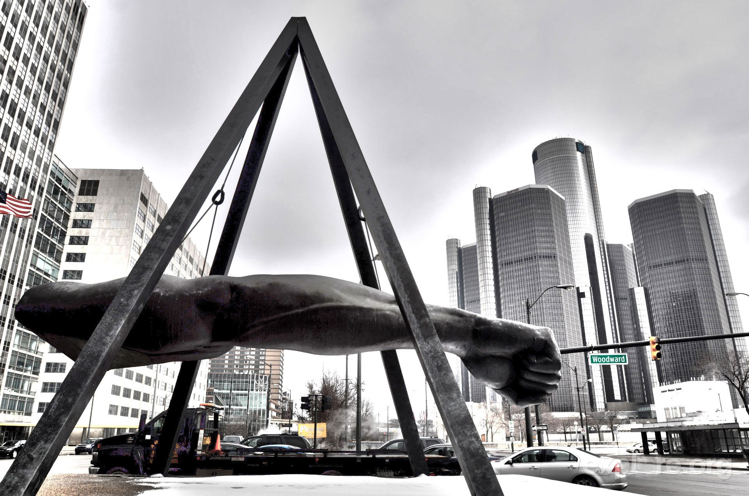
DETROIT Comeback City
Presentation to Leadership Detroit
November 17th, 2016

Slide 3
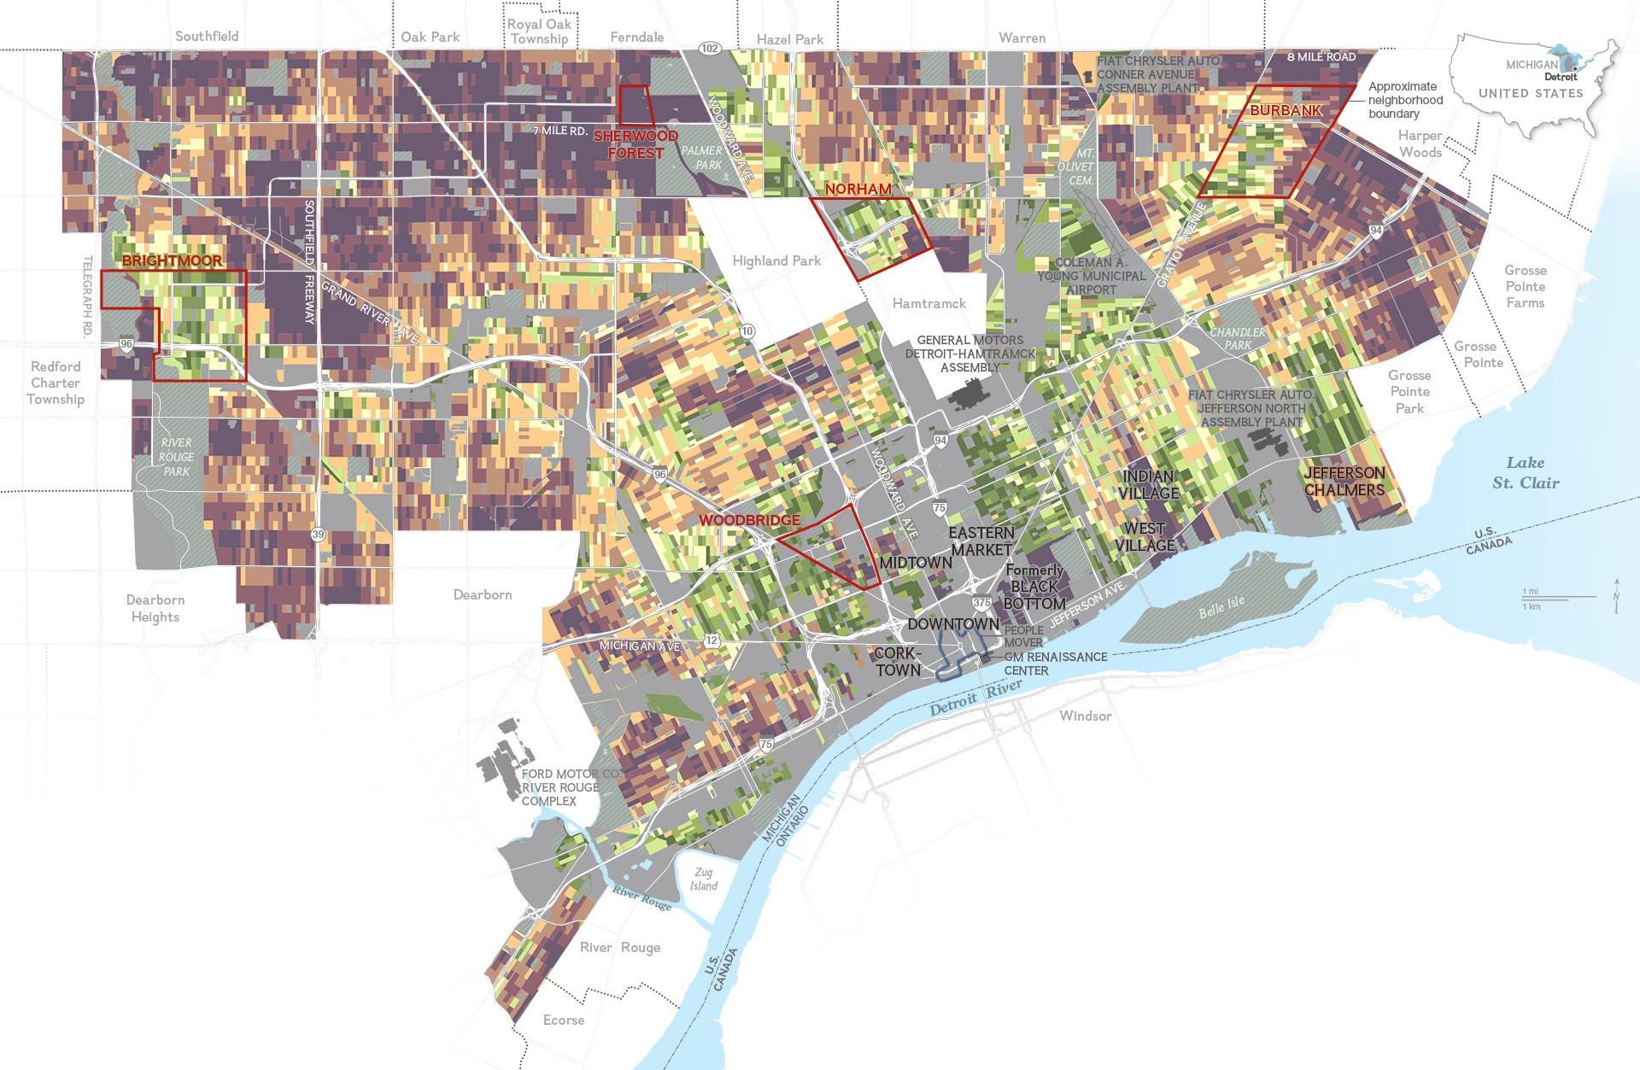
Detroit’s Motto
Speramus meliora; resurget cineribus
“We hope for better things; it will arise from the ashes”
Population: 680,250 People
139 sq. miles
Ethnic Mix- 81.5% Black, 12.8% White, 5.7% Other
Founded in 1701

Slide 4
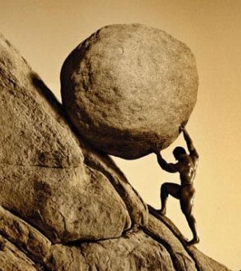
Detroit’s Challenges
High levels of poverty
Reputation challenges
Struggling education system and low levels of attainment
Population decline each year since 1950
from 1.8 million to 700,000
Significant infrastructure investment needed
Broken Institutions
Historically, the lack of good governance
Notes:
Investments (last 5 years)
$3.1 Billion in investment
Over 30,000 new and retained jobs
Workforce
DESC providing workforce solutions
Strong partnership

Slide 9
Detroit’s Challenges
Population
Census/Year | Detroit | Detroit Metro
1950 | 1,849,568 | 3,016,197
2010 | 713,862 | 4,296,250
2014 (estimated) | 680,250 | 4,255,998
Notes:
The challenges within a community are most clearly reflected to us by the most vulnerable of the population.
When the community thrives – the vulnerable will thrive.
Here’s the story in Detroit…….
Percentage of those with less than a high school education is twice that of Michigan’s rate.
(Taken from 2015 Federal Reserve Pres. Slide)

Slide 10
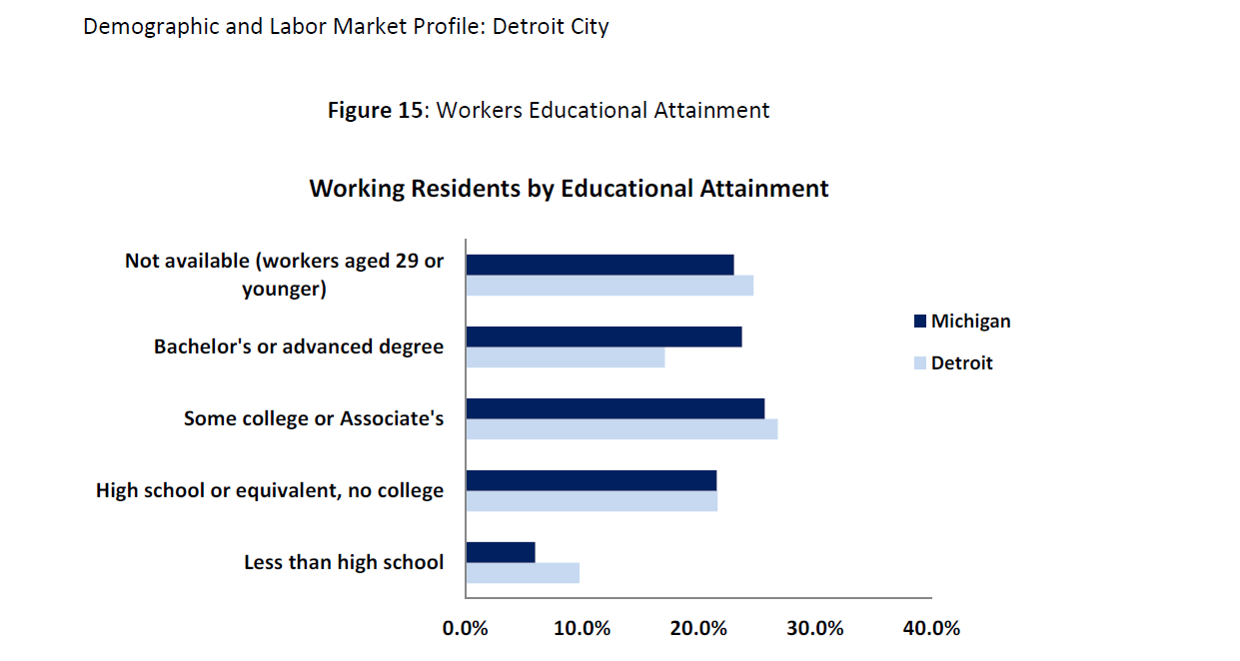
Notes:
Prepared by State of Michigan Department of Technology, Management, and Budget- April 2015

Slide 11

Key principles to build The economy
Plan
Partnership
People
Population
Publish
Notes:
Plan - Detroit needs a strategic plan that works to drive investment. Detroit Future City gave us a framework
Partnership - Can’t be every man for himself. Detroit important to state and regional survival, Region important to Detroit’s survival
People – Detroit will not continue to grow without opportunities for everyone. Decrease the gab between the haves and have not’s
Population - Grow population base. Young talent want strong urban core
Publish – We need to own our story. Outsiders don’t “get it” so we need to make message clear and frequent
Business Leadership – Public Sector Facilitation – Community Engagement
Participation of all people
Recognition and participation in changing global market
Innovate based on best practices

Slide 12

Ford Mustang Mach Prototype

Slide 13
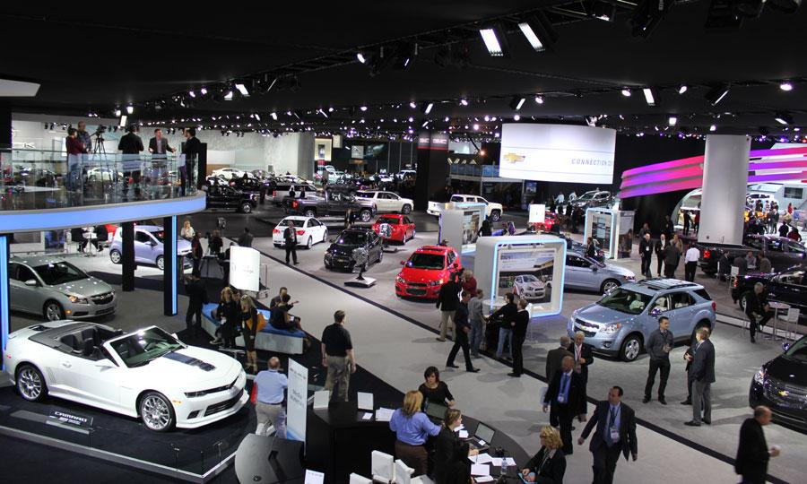
Detroit, Michigan- North America’s Automotive Center

Slide 14
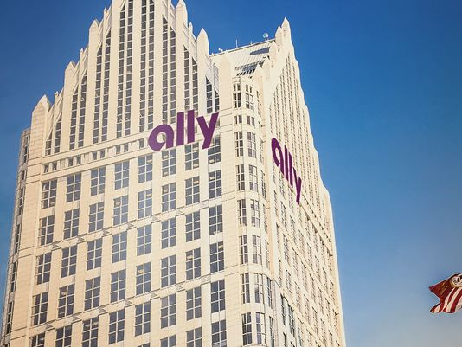
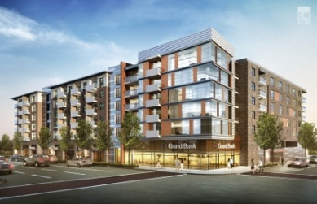
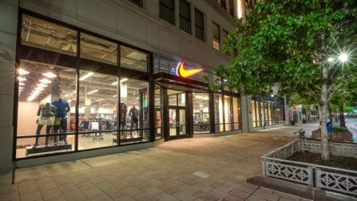
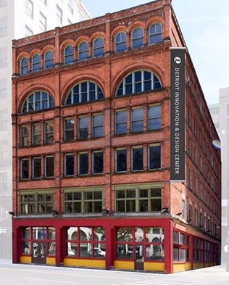
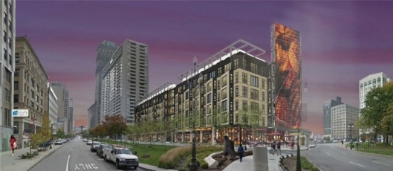
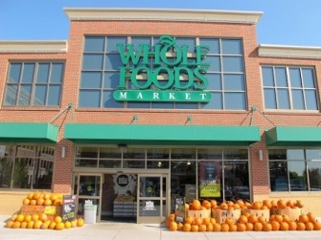
Private Real-Estate Investment is Pouring into City
$12 Billion in planned, active, or completed developments in Detroit since 2006, with nearly $9.4 Billion located in the greater downtown area¹
Commercial
Residential
Retail
300,000 sq ft of office space absorbed since 2013; and 93% occupancy for Class A²
98% occupancy and over 6,700 new residential units in the development pipeline³
352+ retail establishments and 378+ restaurants in greater downtown, with more opening each month³
Ally signed
13-year lease on new office in downtown Detroit to house 1,500 employees
Statler Building: $40M development with 290 units, restaurant, and retail
Nike opened in Downtown Detroit in 2016
Lear invested $15.6M in two downtown properties for innovation and design center
3rd & Grand: $53M development with 231 apartments and 20k sq ft of retail
Whole Foods opened in Midtown Detroit
in 2013, seeking second location in 2016
1. Detroit Regional Chamber 2. Detroit Economic Growth Corporation 3. BedrockDetroit Matter of Fact Book and 7.2 SQ MI Report.
Note: Greater downtown includes Central Business District, Midtown, Eastern Market, Corktown, Rivertown, Woodbridge, and Lafayette Park neighborhoods.
Notes:
Examples of Slide Designs

Slide 15



“Businesses want to be in Detroit”
2015, 2014 x in jobs y in capital--- 2015 Progress Report
Flex-N-Gate
Sakthi Automotive
Ally Financial
Flex-N-Gate: $95 million investment to build a facility that will supply parts to Ford
Occupy 30 acres
Facility 350,000 to 500,000 square feet
400 jobs created; 750 possible jobs
$3.5 million grant by the Michigan Strategic Fund to assist with Next Michigan Corporation Designation
Acquired Land from EDC
Expanded Detroit plant to include R & D and additional production of aluminum castings.
90% of its aluminum castings work will now take part in the Detroit plant.
DEGC provided assistance for Tax Abatement and workforce programs
.
Total Expected Investment: $31.8 Million, and 350 new jobs
Approximately 350 Ally employees are moving into Ally Detroit Center this month. Ally expects the majority of the 1,500 team members (employees and contract professionals) to be moved in by November 2016.
Ally will employ approximately 200 independent third party contractors and vendors in the city of Detroit.
DDA agreed to pay estimated $1M per year for ten years. Agreement has not been signed yet proposed disbursements are likely to begin in 2019.
Notes:
Examples of Slide Designs

Slide 16
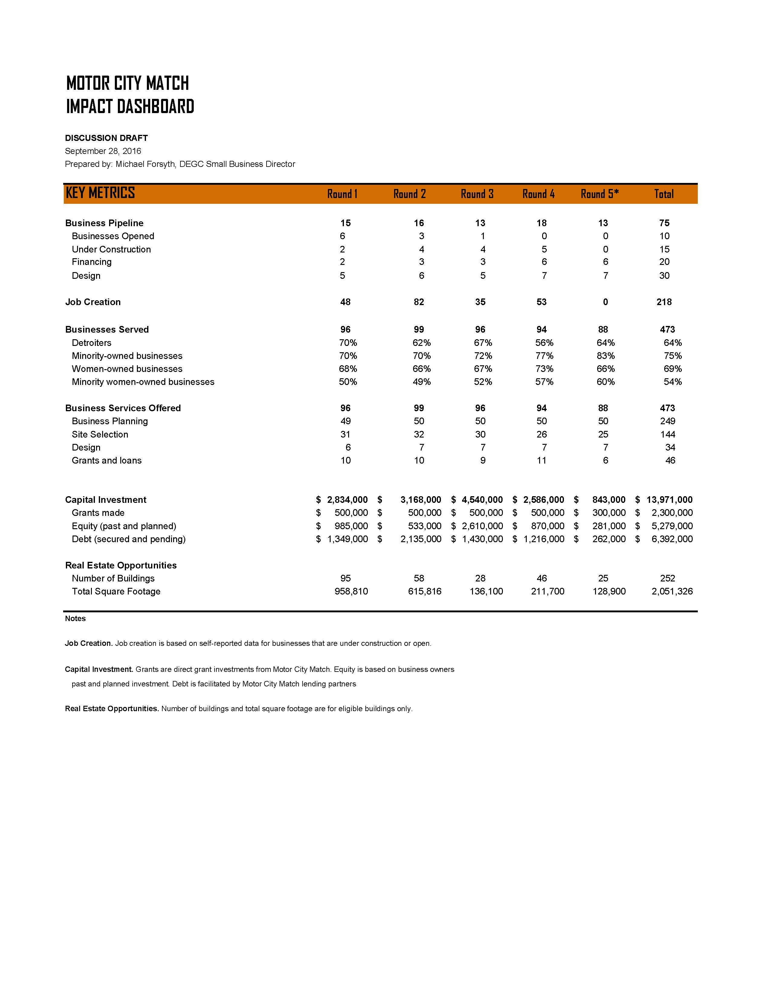

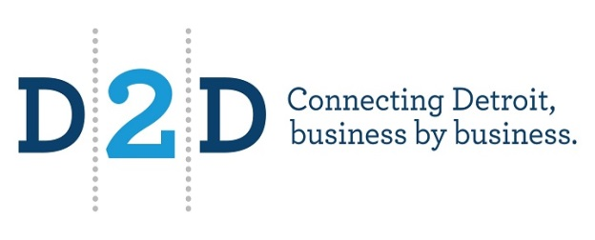
DEGC Small Business
Expected investment for GGP stores’ new construction, expansions and renovations will exceed $50 million in investment
GGP awarded $540,000 in façade improvement program matching grants to 18 Detroit stores that will result in over $5 million in investment
GGP financing support for two independent Detroit grocers with total investment of over $11 Million
Buyers Council 2015 purchases from Detroit Based companies: $856 Million
13 Events held with D2D participation
$228.5m Approximate aggregate development investment
Notes:
Examples of Slide Designs

